Slide 1
Automatic program repair
2020-02-03
JuHyoung Kim
kjhkjh75@naver.com

Slide 2
- Contents
Summary
Progress
Research Scenario
Technique`s pattern extraction and match
Issue
Future work

Slide 3
- Summary
Recently APR techniques characteristics and Comparisons for improvement
Each Techniques have their own granularity about AST configuration.

Slide 4
- Progress
Previous Work
- Capgen vs SimFix Extraction.
Processing work
- Tbar time cost and Extraction, Ubuntu processing
Future work
- Calculate Time and Rank Techniques.

Slide 5
- Real scenario
Using Bug code, checking pattern existence.
If both techniques have pattern, check AST configuration
Using technique`s AST utilization.
Can predict which techniques more effective ( in terms of correctness, time)

Slide 6
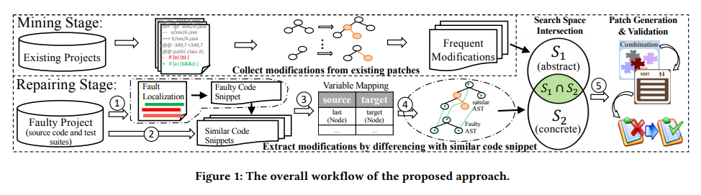
- SimFix
Using extracted code snippet between maximum [-5,5] as the faulty snippet (enough snippet)
Variable`s parent node type

Slide 7
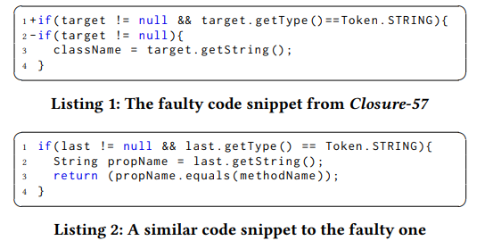

- SimFix
Ex)_

Slide 8
- CapGen
Ancestor Node level
Checking its sibling nodes to see what types of code elements.
Bug statement.

Slide 9
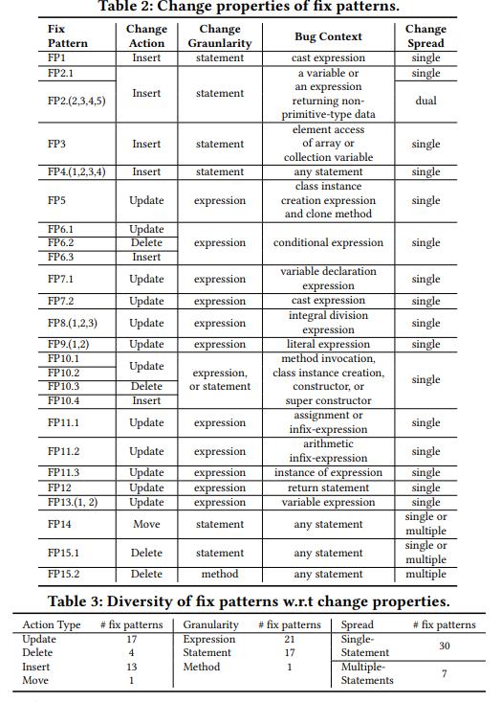
- Matching Pattern
TBar
Fix pattern Selection
1. Tbar sequentially traverse each node of the suspicious statement AST from its first child to its last leaf node
2. Try to match each node against the context AST of the fix patterns
method invocation, if statment ,return statement

Slide 10
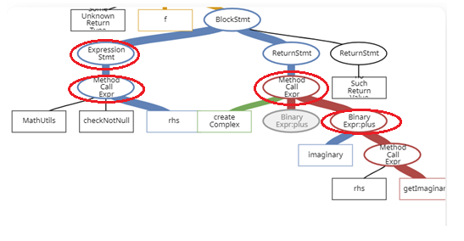
- Tbar AST extraction.

Slide 11
-Prediction result
prediction rate 24/33
capgen : 9/12
simfix : 15/21

Slide 12
- Future work
Comparison 1:1 techniques or Rank what techniques is better.

